Slide 1
AWS S3 Buckets List using Lambda Function with Python

Slide 2
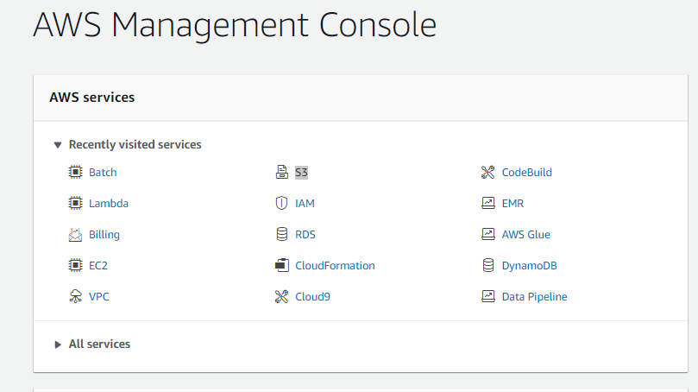
Go to Aws console and open S3

Slide 3
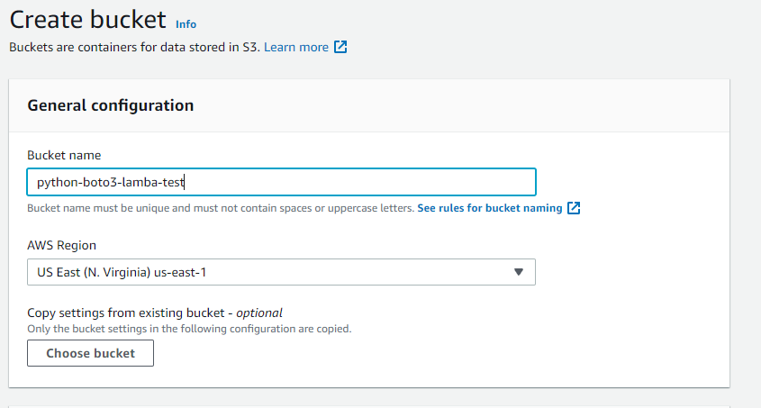
Create S3 bucket

Slide 4
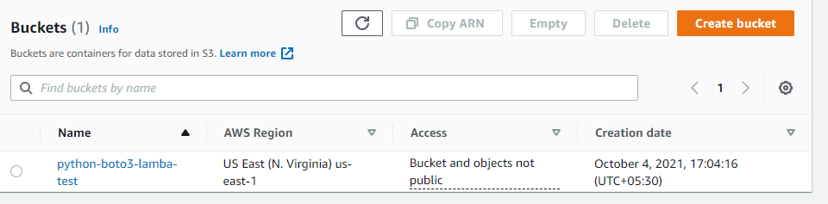
Bucket created

Slide 5
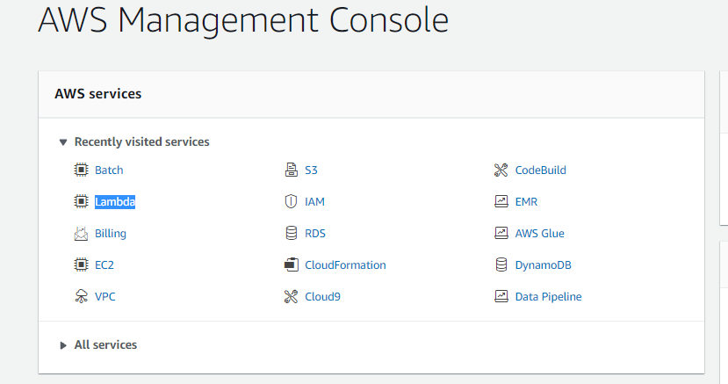
Now open Lambda

Slide 6
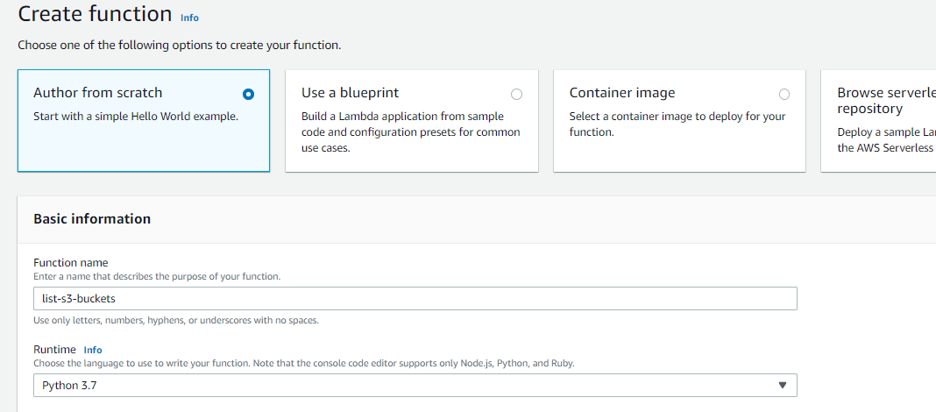
Create a Lambda function

Slide 7
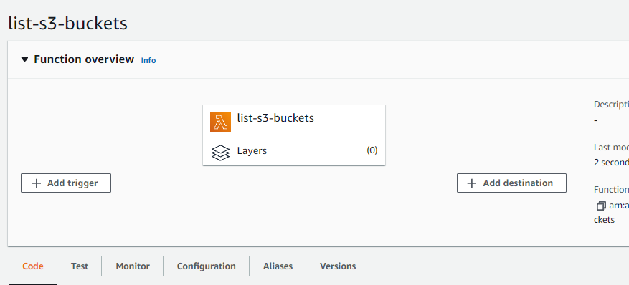
Lambda function created

Slide 8
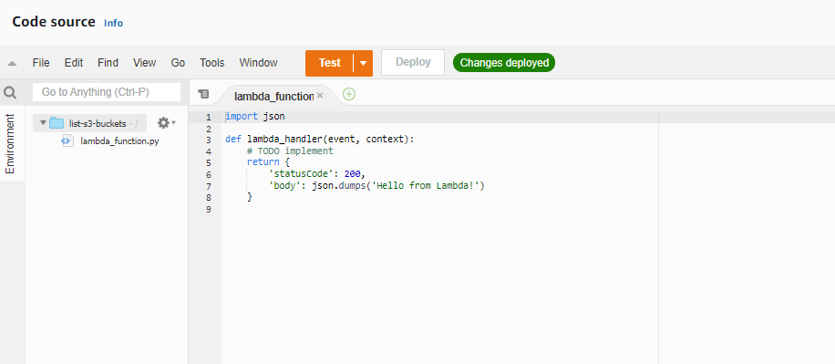
A python source code is provided there we need to change it

Slide 9
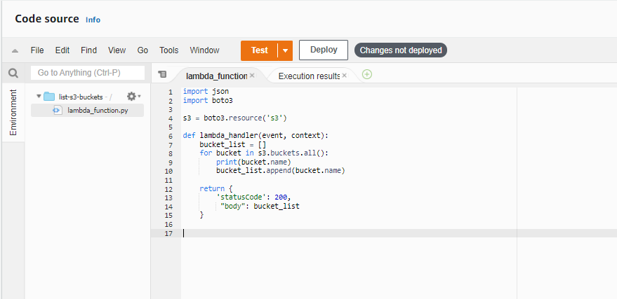
This is the new code and run the code
https://github.com/vishnuvs369/Aws-Python.git

Slide 10
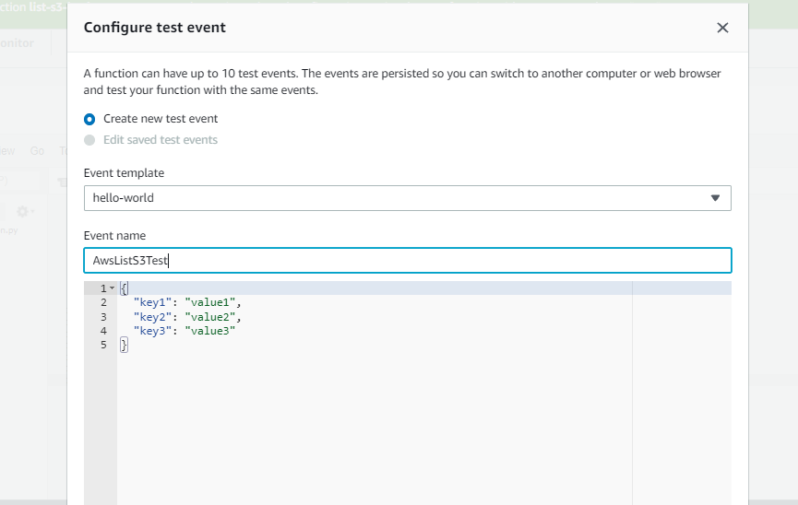
Create an event

Slide 11
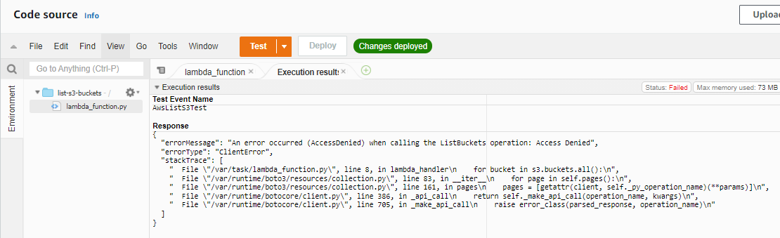
Access is denied. We have to provide AWS S3 access

Slide 12
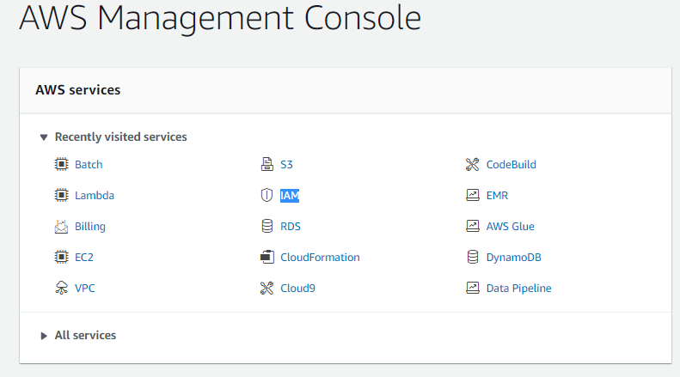
So go to IAM

Slide 13
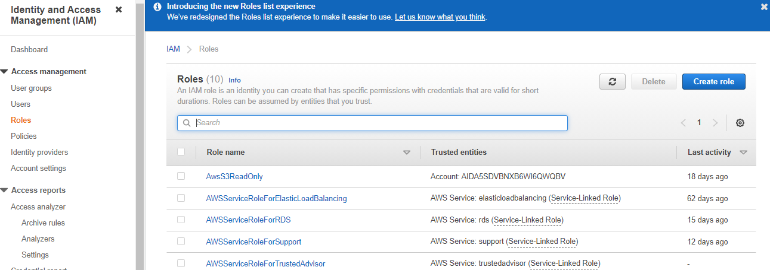

Slide 14
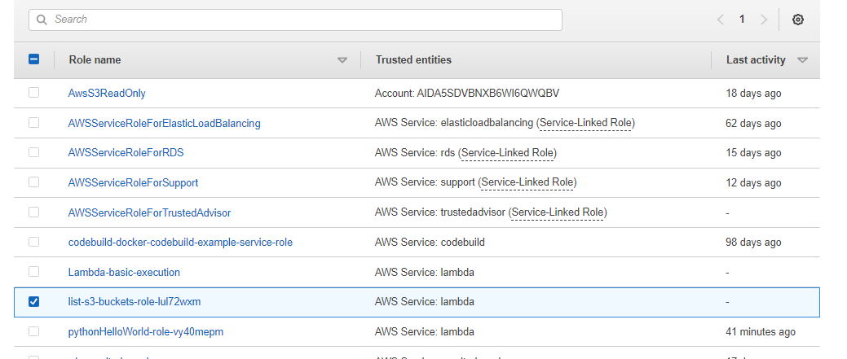
We can see our role there

Slide 15
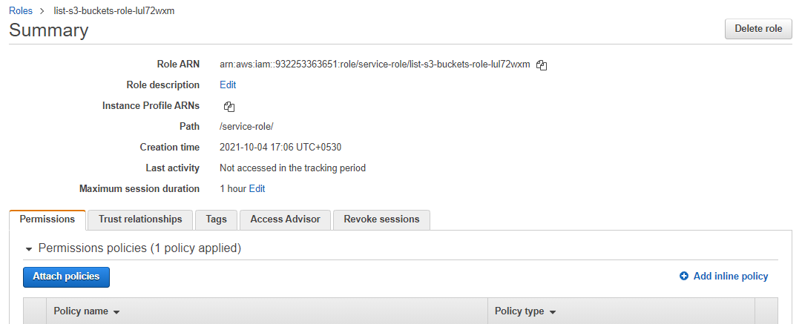
Attach policy for the role

Slide 16
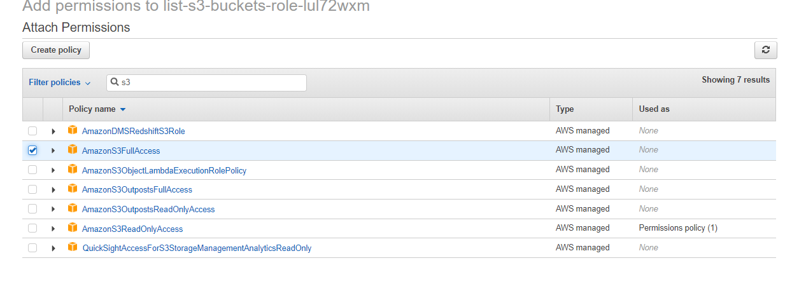
S3 Full Access is given and run the code again

Slide 17
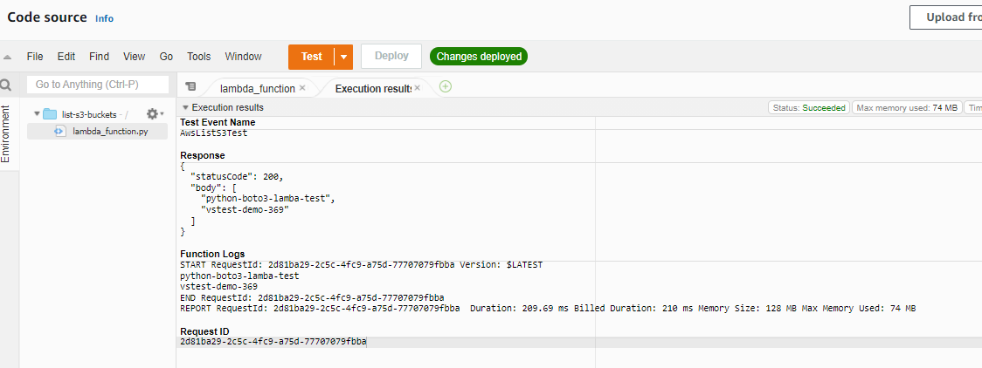
So the bucket list is displayed there

